Slide 1


Introduction to DAOs
MINTA ALCÍM

Slide 2
Definition of DAOs
A decentralized autonomous organization (DAO) is an organization managed in whole or in part by decentralized computer program, with voting and finances handled through a blockchain. In general terms, DAOs are member-owned communities without centralized leadership.

Slide 3

Historical Evolution of DAOs
Some argue that the first DAO was Bitcoin itself, because of its decentralized governance and autonomous operation. However, Bitcoin does not have a Treasury system yet, such a system was introduced with Dash, in 2014.

Slide 4
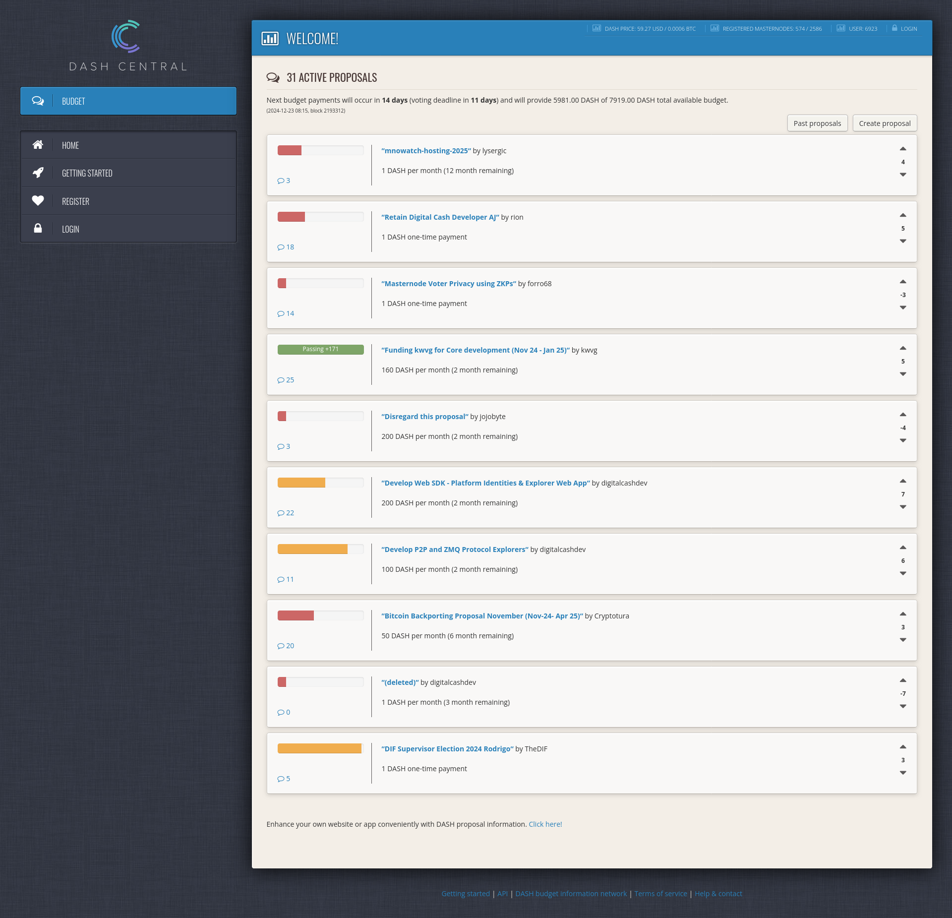
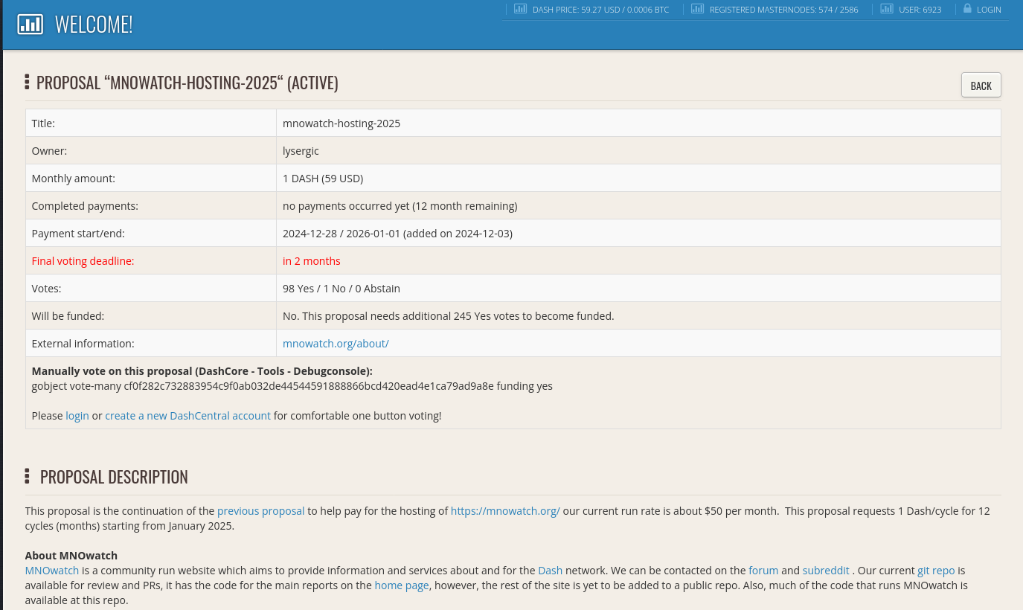

Slide 5
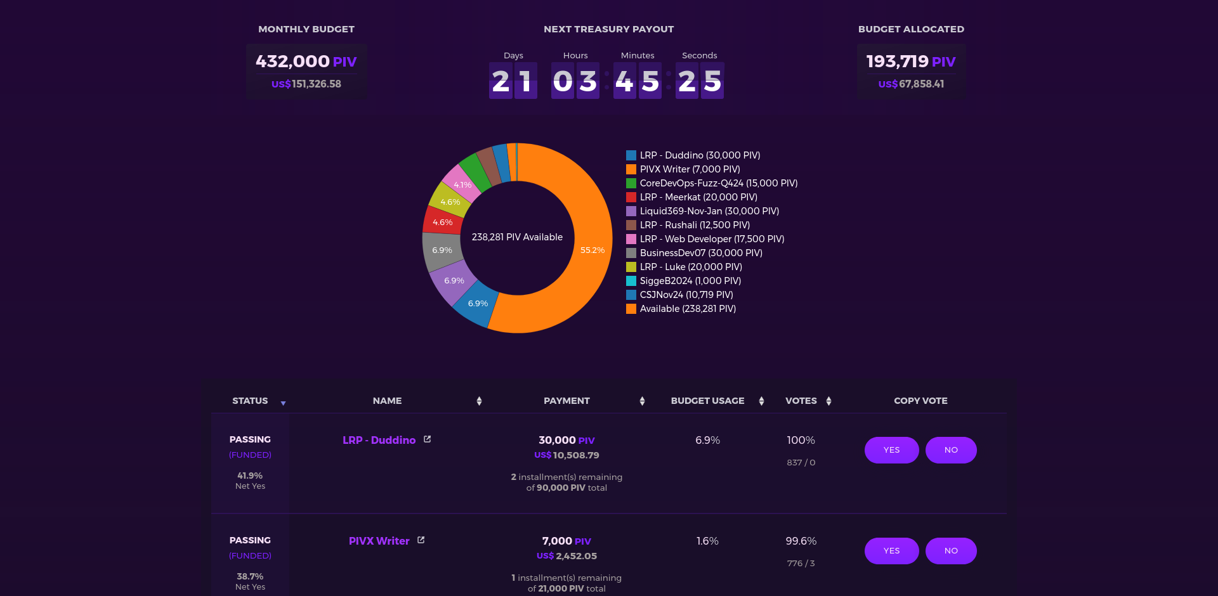

Slide 6
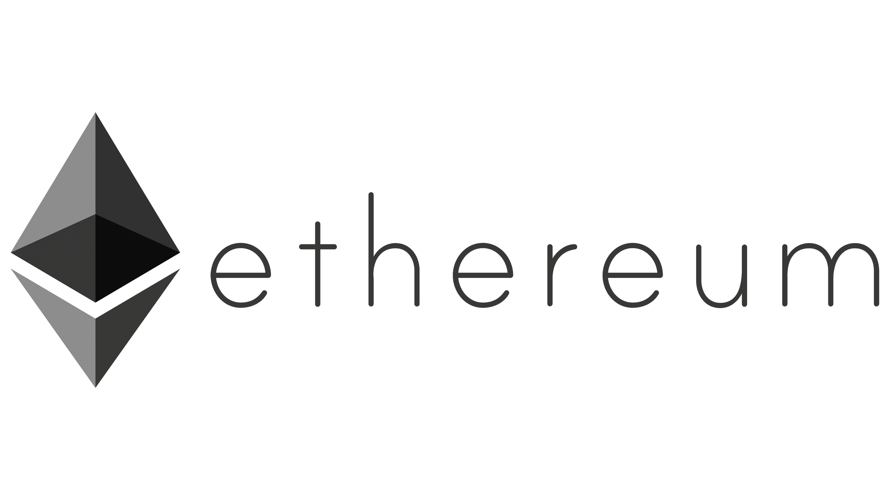
The DAO
The DAO was a digital decentralized autonomous organization and a form of investor-directed venture capital fund. After launching in April 2016 via a token sale, it became one of the largest crowdfunding campaigns in history, but it ceased activity after much of its funds were taken in a hack in June 2016. Ethereum introduced the concept of Turing-complete smart contracts, and its DAO was developed in this system.

Slide 7
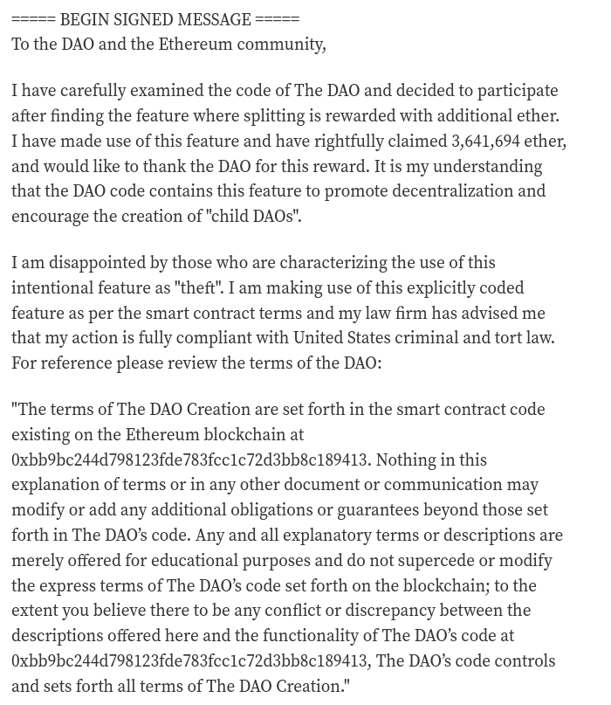
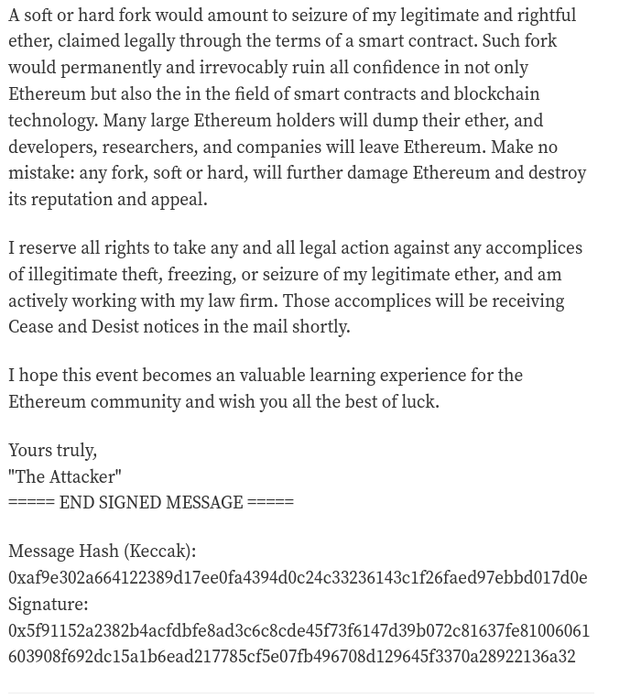

Slide 8
Cryptocurrencies with Treasury Mechanisms
Some cryptocurrencies that has Treasury:
Dash
Decred
Horizen (ZenCash)
PIVX
Cardano
Polkadot

Slide 9
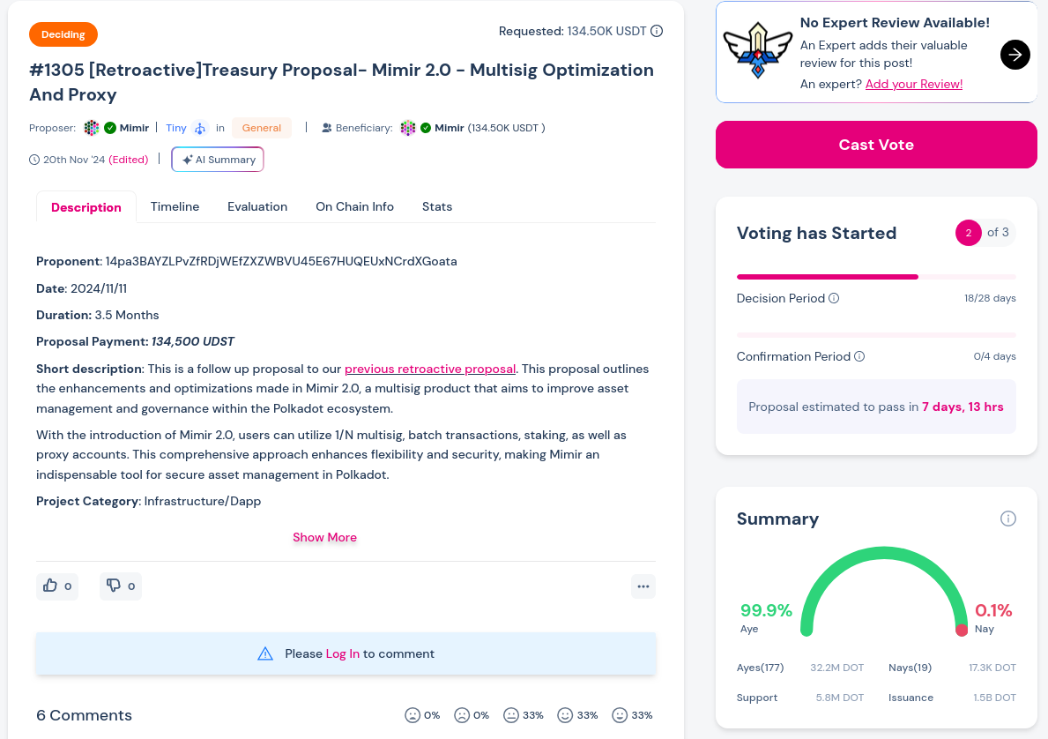
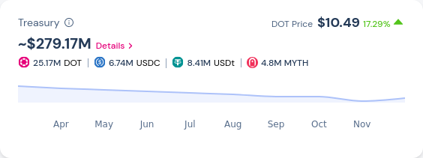

Slide 10
DAO Frameworks and Tooling
Ethereum (Solidity)
Aragon
DAOstack
Colony
MolochDAO
Safe ( Gnosis Safe)
Polkadot (Rust)
SubDAOs (native within Substrate)
Polkadot Governance Framework

Slide 11
Organizational Challenges in DAOs
Some problems to highligh:
Traditional hierarchical thinking doesn't disappear in DAOs
Informal leadership emerges despite decentralized structures
Language and cultural barriers in global communities
Constant voting and proposal processes can lead to burnout
Economic interests don't always align with community goals
Whale/large token holder dominance
Not all members have equal understanding of technical or strategic issues
Lack of traditional mediation processes
Limited enforcement mechanisms

Slide 12
Some Resources related to Organizational Challenges
So You’ve Got a DAO by Grace Rachmany
Blueprint for Decentralization (main author is Grace Rachmany)
Research Sociocracy
Research Holocracy
Research Citizen Assemblies
The Starfish and the Spider: The Unstoppable Power of Leaderless Organizations by Ori Brafman
Blueprint for Revolution by Srdja Popovic and Matthew Miller

Slide 13
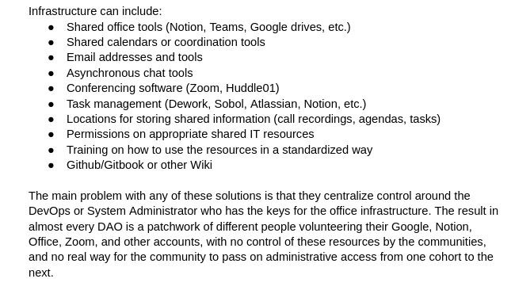
Centralization Risks in Decentralized Systems

Slide 14
Another forms of Centralization Risks
Financial Centralization: Venture capital influence, whales
Geographical Centralization
Server locations
Regulatory environments
Developer concentration in specific regions
Technical Decision-Making Centralization
Small groups often make critical protocol decisions
Informal power stuctures emerge
Potential for ideological or economic bias

Slide 15
Real World DAO Use Cases
MakerDAO: Manages the DAI stablecoin ecosystem
UkraineDAO: Created to support Ukraine during the Russian invasion. Raised millions of dollars in cryptocurrency to support humanitarian efforts
CityDAO: Purchased land in Wyoming to experiment with blockchain-based land ownership
LexDAO: Club of legal engineering professionals united to bring the traditional legal settlement layer to code and coded agreements for the masses.
Terra0: Experimental project exploring blockchain-based forest management
ReFi DAO: Regenerative Finance DAO supporting climate and environmental projects

Slide 16
Legal and Regulatory Landscape
Wyoming has a legal structures for DAOs (“Wyoming DAO LLC”). The legislation was passed in 2021.
There is no consistent internation legal framework for DAOs. Mostly DAOs are registered as a company/non-profit, the state is looking at it as a normal corporation, on the other hand, the community looks at it as a decentralized organization.

Slide 17
Future Potential and Limitations of DAOs
In summary, there are both technological and social/psychological challenges related to DAOs, but there are developments in both fields.

